Slide 1

Etherisc
Smart insurance applications on the blockchain
November 2016

Slide 2
Vision
Insurance is a trillion dollar market and ripe for disruption.
Decentralized applications on programmable blockchains make insurance much more efficient.
We want to disrupt insurance ...
… by building smart insurance applications which are highly automated, provably fair and highly customizable.
… by creating a truly decentralized marketplace for sharing risks..
Notes:
(no long-term relations, coordination, independent deployment)

Slide 3
Goals for the hackathon
Implement a token model for a decentralized insurance marketplace
Create a great user experience for customers and investors
Notes:
(no long-term relations, coordination, independent deployment)

Slide 4
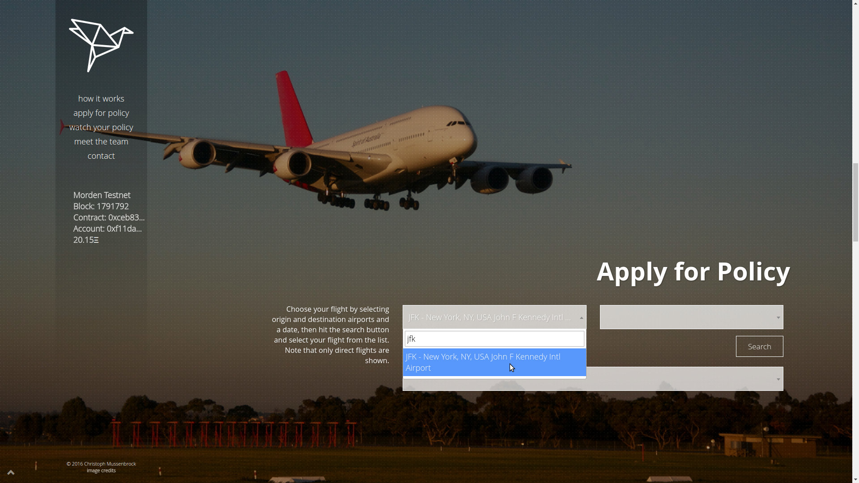
Our solution: Flight delay, fdd.etherisc.com
We launched the first operational insurance application on the Ethereum blockchain in September 2016 for devcon2.
Fully automated insurance process with a great user experience.
Notes:
(no long-term relations, coordination, independent deployment)

Slide 5
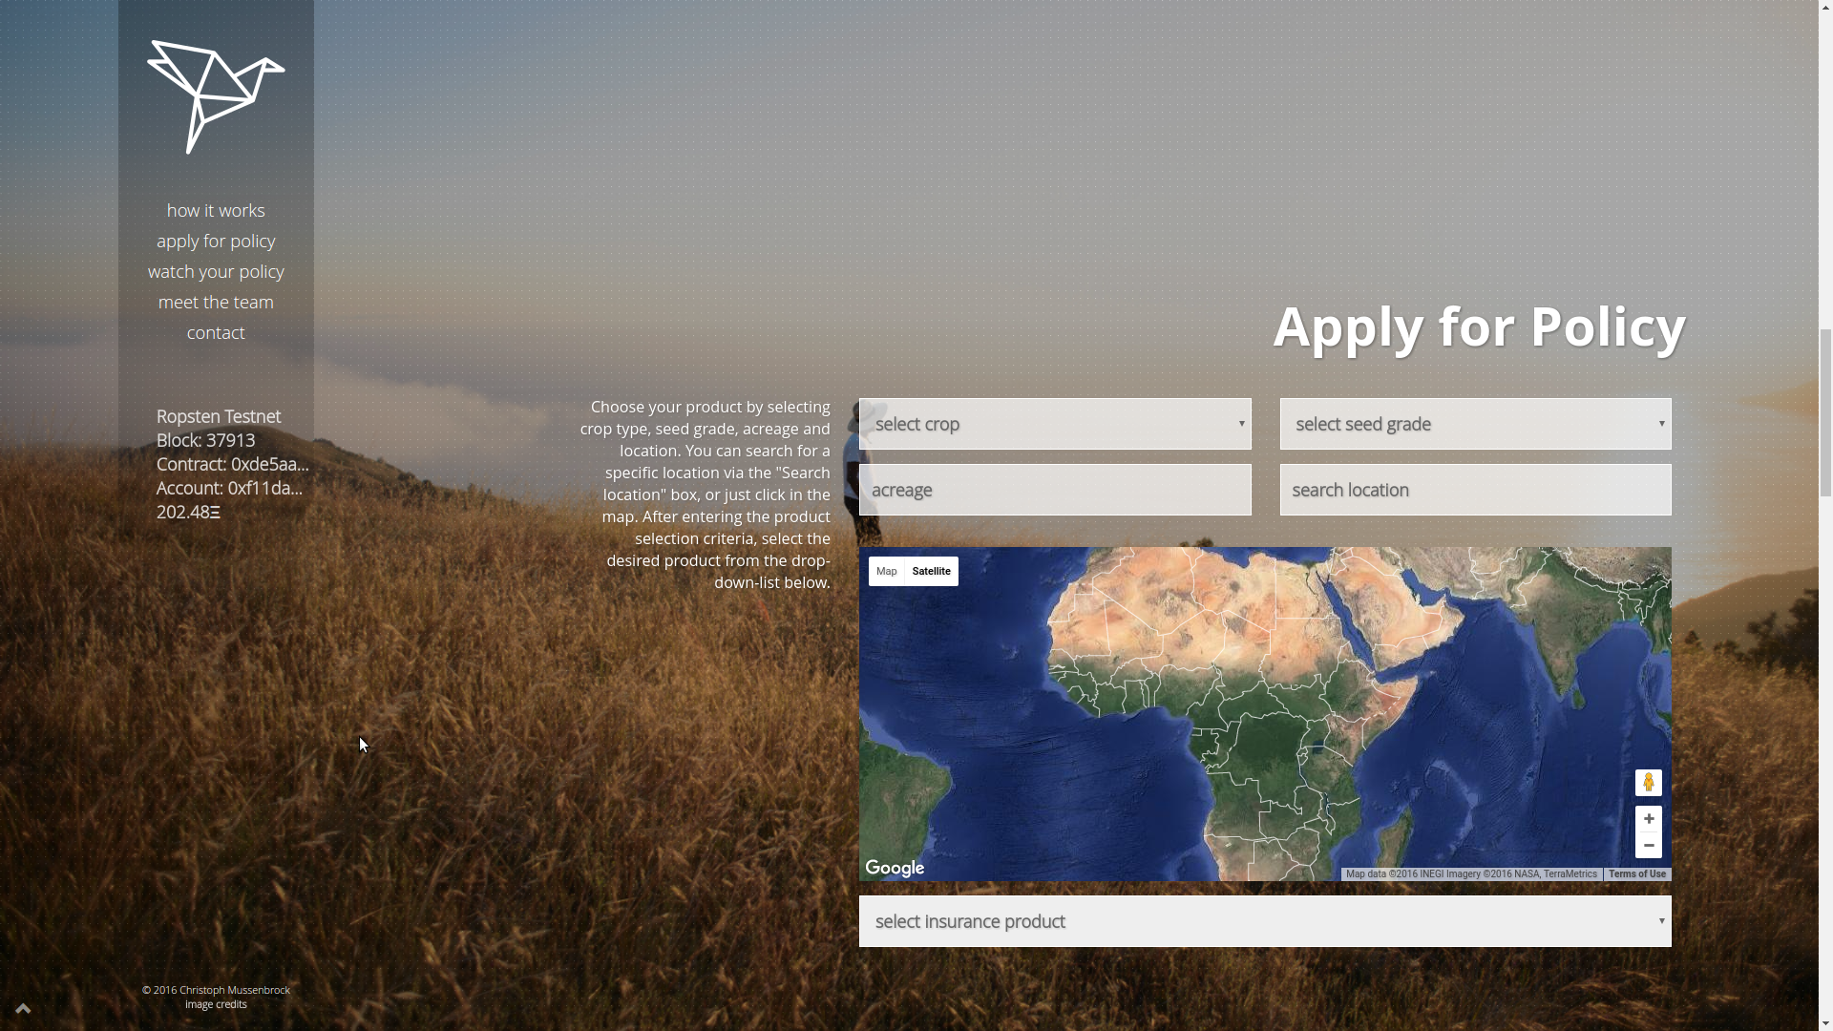
Our solution: Crop insurance, crop.etherisc.com
Same model of parametric insurance, easy to apply to other verticals
Notes:
(no long-term relations, coordination, independent deployment)

Slide 6
Current status
We are currently working on an end-to-end decentralized marketplace for risk sharing with a token model for investors.
First paying customer is a German financial service provider, for whom we build a production blockchain integration.
Two more opportunities in the pipeline, talking to many large insurance companies (with slow decisions and long sales cycles).
Incorporated in the UK, now incorporating in Germany.
We are the first blockchain insurance company to apply for
regulatory sandbox approval with the FCA in the UK.
Notes:
(no long-term relations, coordination, independent deployment)

Slide 7
Our solution
Add token model …
Add whitepaper ..
Notes:
(no long-term relations, coordination, independent deployment)

Slide 8


Team
Christoph Mussenbrock – Former CEO of parcIT GmbH, providing risk management solutions for cooperative banks, many years of work experience in banking and insurance in Germany.
Christoph has a master’s degree in mathematics and wrote his thesis on formal software and hardware verification.
https://www.linkedin.com/in/christoph-mussenbrock
Stephan Karpischek – Managing director at disrupt consulting, a digital strategy consulting cooperative. Former business analyst for blockchain innovation at UBS, many years of work experience in IT, consulting and education in Austria, Switzerland and UK.
Stephan has a PhD in Information Management from ETH Zurich and wrote his thesis on mobile applications for the Internet of Things.
https://www.linkedin.com/in/karpischek
Notes:
(no long-term relations, coordination, independent deployment)

Slide 9
Team
Add yourself here
Notes:
(no long-term relations, coordination, independent deployment)

Slide 10
Media
Lessons learned from our Flight Delay Dapp: https://medium.com/the-future-requires-more/flight-delay-dapp-lessons-learned-a59e4e39a8d1
Demo video: https://www.youtube.com/watch?v=ED1-HaWEnRs
News article on Flight Delay Dapphttps://www.cryptocoinsnews.com/blockchain-disrupt-air-travel-insurance-flightdelay/
Q&A with coinfund: https://www.youtube.com/watch?v=baRg0iCPrK8
Camp zoom video:
Notes:
(no long-term relations, coordination, independent deployment)

Slide 11
Contact us!
Camp: https://hack.ether.camp/public/a-truly-decentralized-p2p-insurance
Chat: https://gitter.im/etherisc
Email: contact@etherisc.com
Phone: +49 160 908 333 92 (Christoph)
    +43 664 191 80 46 (Stephan)
Notes:
(no long-term relations, coordination, independent deployment)

